Slide 1
COMP3028 Software Architecture

Slide 2
Review

Slide 3
Architecture and Requirements
System requirements can be categorized as:
Functional requirements state what the system must do, how it must behave or react to run-time stimuli.
Quality attribute requirements qualify functional requirements, e.g., how fast the function must be performed, how resilient it must be to erroneous input, etc.
Constraints. A constraint is a design decision with zero degrees of freedom.

Slide 4
Quality Attribute Considerations - example
If a functional requirement is "when the user presses the green button the Options dialog appears”:
a performance qualification might describe how quickly the dialog will appear;
an availability qualification might describe how often this function will fail, and how quickly it will be repaired;
a usability qualification might describe how easy it is to learn this function.

Slide 5
Two Categories of Quality Attributes
The ones that describe some properties of the system at runtime
Availability, performance, usability, security
The ones that describe some properties of the development of system
Modifiability
Testability

Slide 6
Quality Attribute Considerations
There are problems with previous discussions of quality attributes:
Untestable definitions. The definitions provided for an attribute are not testable. It is meaningless to say that a system will be “modifiable”
Overlapping concerns. Is a system failure due to a denial of service attack an aspect of availability, performance, security, or usability?

Slide 7
Quality Attribute Considerations
A solution to the problems (untestable definitions and overlapping concerns) is to use quality attribute scenarios as a means of characterizing quality attributes.

Slide 8
Specifying Quality Attribute Requirements
We use a common form to specify all quality attribute requirements as scenarios.
Our representation of quality attribute scenarios has these parts:
Stimulus
Stimulus source
Response
Response measure
Environment
Artifact

Slide 9
Specifying Quality Attribute Requirements
Stimulus. The stimulus is a condition that requires a response when it arrives at a system.
Source of stimulus. This is some entity (a human, a computer system, or any other actuator) that generated the stimulus.
Response. The response is the activity undertaken as the result of the arrival of the stimulus.
Response measure. When the response occurs, it should be measurable in some fashion so that the requirement can be tested.
Environment. The stimulus occurs under certain conditions. The system may be in an overload condition or in normal operation, or some other relevant state.
Artifact. This may be a collection of systems, the whole system, or some piece or pieces of it. Some artifact is stimulated.

Slide 10
Specifying Quality Attribute Requirements
General quality attribute scenarios are system independent and can, potentially, pertain to any system
Concrete quality attribute scenarios are specific to the particular system under consideration.

Slide 11
Achieving Quality Attributes Through Tactics
There are a collection of primitive design techniques that an architect can use to achieve a quality attribute response.
We call these architectural design primitives tactics.
Tactics, like design patterns, are techniques that architects have been using for years.
We do not invent tactics, we simply capture what architects do in practice.

Slide 12
Availability General Scenario
Portion of Scenario | Possible Values
Source | Internal/external: people, hardware, software, physical infrastructure, physical environment
Stimulus | Fault: omission, crash, incorrect timing, incorrect response
Artifact | System’s processors, communication channels, persistent storage, processes
Environment | Normal operation, startup, shutdown, repair mode, degraded operation, overloaded operation
Response | Prevent the fault from becoming a failure Detect the fault: log the fault notify appropriate entities (people or systems) Recover from the fault disable source of events causing the fault be temporarily unavailable while repair is being effected fix or mask the fault/failure or contain the damage it causes operate in a degraded mode while repair is being effected
Response Measure | Time or time interval when the system must be available Availability percentage (e.g. 99.999%) Time to detect the fault Time to repair the fault Time or time interval in which system can be in degraded mode Proportion (e.g., 99%) or rate (e.g., up to 100 per second) of a certain class of faults that the system prevents, or handles without failing

Slide 13
Sample Concrete Availability Scenario
The heartbeat monitor determines that the server is nonresponsive during normal operations. The system informs the operator and continues to operate with no downtime.

Slide 14
Goal of Availability Tactics

Slide 15
Availability Tactics

Slide 16
End of review

Slide 17
Software Architecture
Quality attributes: Interoperability

Slide 18
Intended Learning Outcomes
By the end of this lesson you will be able to:
apply the design decision categories to interoperability

Slide 19
What is Interoperability?
Interoperability is about the degree to which two or more systems can usefully exchange meaningful information via interfaces in a particular context.
Any discussion of a system’s interoperability needs to identify with whom, and under what circumstance.

Slide 20
What is Interoperability?
Syntactic interoperability is the ability to exchange data.
Semantic interoperability is the ability to interpret the data being exchanged.

Slide 21
Questions to think about when designing system for interoperability
Will this system need to provide services to other system(s)? What do we know about these systems?
Will this system be constructed by combining capabilities from other systems?

Slide 22
What is Interoperability?
Two perspectives for achieving interoperability
With the knowledge about the interfaces of external systems, design that knowledge into the system
Without the knowledge about other systems, design the system to interoperate in a more general fashion

Slide 23
Motivation
The system provides a service to be used by a collection of unknown systems, eg., GoogleMaps
The system is constructed from existing systems, for example
Producing a representation of what was sensed
Interpreting the data
Processing the raw data
Sensing the environment

Slide 24
Two Important Aspects of Interoperability
Discovery. The consumer of a service must discover the location, identity, and interface of service
Handling the response. Three possibilities:
The service reports back to the requester
The service sends its response on to another system
The service broadcasts its response to any interested parties

Slide 25

Open Question
Points: 10
What question can you ask the client to find out if the system has requirements of interoperability?
You cannot use word “interoperability” in your question
Open Question is only supported on Version 2.0 or newer.
Answer

Slide 26
Example
Will this system need to provide services to other system(s)? What do we know about these systems?
Will this system be constructed by combining capabilities from other systems?
Example - a traffic sensing system where the input comes from individual vehicles, the raw data is processed into common units of measurement, is interpreted and fused, and traffic congestion information is broadcast
one of the existing systems is responsible for sensing its environment
another one is responsible for processing the raw data
a third is responsible for interpreting the data
a final one is responsible for producing and distributing a representation of what was sensed

Slide 27
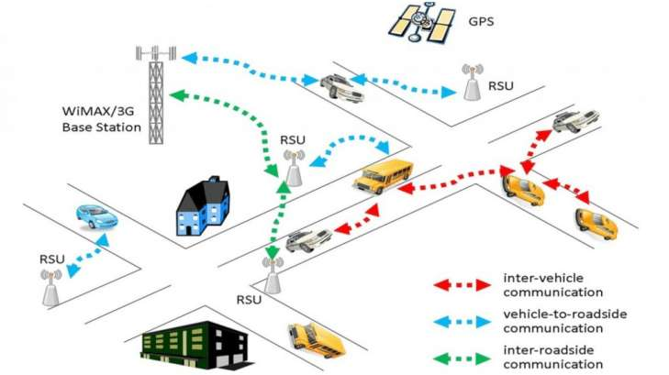
Intelligent transportation system

Slide 28
Interoperability General Scenario
Portion of Scenario | Possible Values
Source | A system
Stimulus | A request to exchange information among system(s).
Artifact | The systems that wish to interoperate
Environment | System(s) wishing to interoperate are discovered at run time or known prior to run time.
Response | One or more of the following: the request is (appropriately) rejected and appropriate entities (people or systems) are notified the request is (appropriately) accepted and information is exchanged successfully the request is logged by one or more of the involved systems
Response Measure | One or more of the following: percentage of information exchanges correctly processed percentage of information exchanges rejected

Slide 29
Intelligent transportation system

Slide 30
Sample Concrete Interoperability Scenario
Our vehicle information system sends our current location to the traffic monitoring system.
The traffic monitoring system combines our location with other information, overlays this information on a Google Map, and broadcasts it.
Our location information is correctly included with a probability of 99.9%.

Slide 31
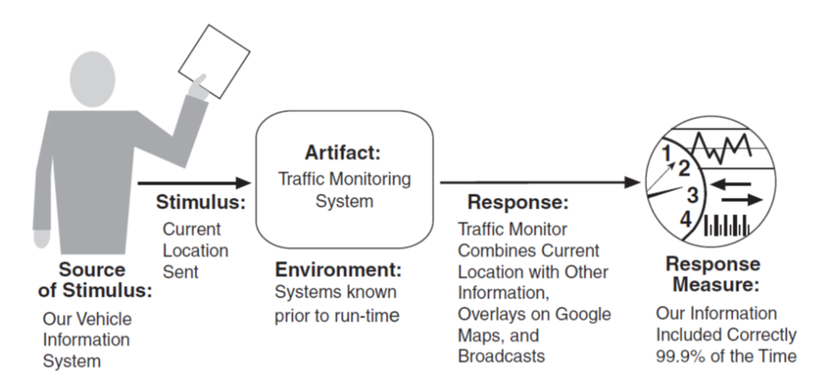
Sample Concrete Interoperability Scenario

Slide 32
Open Question
Points: 10
You want to develop a system that will help customers save money on their online shopping. The customers will specify the products they want to buy on platforms such as Taobao, JD, Pinduoduo, etc, and the system will track the prices and notify the customers by sending them WeChat messages.
Discuss interoperability requirements for this system
Write several concrete interoperability scenarios for this system.
Open Question is only supported on Version 2.0 or newer.
Answer

Slide 33
SOAP v.s. REST
Two technology options to allow the web-based application to interoperate
SOAP is used in SOA systems along with a set of protocols
Service description& discovery, e.g., WSDL, UDDI
Service composition, e.g., BPEL
SOAP is more complex and used for exchange messages with structured data, while REST is simple and used for small messages

Slide 34
Goal of Interoperability Tactics
For two or more systems to usefully exchange information they must
Know about each other. That is the purpose behind the locate tactics.
Exchange information in a semantically meaningful fashion. That is the purpose behind the manage interfaces tactics. Two aspects of the exchange are
Provide services in the correct sequence
Modify information produced by one actor to a form acceptable to the second actor.

Slide 35
Goal of Interoperability Tactics

Slide 36
Interoperability Tactics

Slide 37
Locate
Service Discovery : Locate a service through searching
There are many service discovery mechanisms:
UDDI for Webservices
Jini for Java objects
Simple Service Discovery Protocol (SSDP) as used in Universal plug-and-play (UPnP)
DNS Service Discovery (DNS-SD)
Bluetooth Service Discovery Protocol (SDP)

Slide 38
Service Discovery – Necessary conditions
The searcher wants to find the searched entity and the searched entity wants to be found
The searched entity must have identifiers
The searcher must acquire sufficient identifiers to identify the searched entity

Slide 39
Open Question
Points: 10
What are the different mechanisms to enable searching for information?
(tip: you can consider trying to find information about good restaurants in the new city that you want to visit. What are the different ways?)
Open Question is only supported on Version 2.0 or newer.
Answer

Slide 40
Locate
Service Discovery : Locate a service through searching

Slide 41
Searching methods
Searcher’s initiative
Searched initiative
Registration – a middleman

Slide 42
Poll
1 answer(s) at most
(select more than one correct answer) Which of the searching methods are initiated by the searcher? (searcher: an entity that searches for some other entity)
A
Broadcast request
B
Continuous advertisement
C
Successive request
D
Advertisement upon arrival of new entity
Submit

Slide 43
Multiple Choice(multiple)
Points: 1
(select more than one correct answer) Which of the searching methods are initiated by the searcher? (searcher: an entity that searches for some other entity)
A
Broadcast request
B
Continuous advertisement
C
Successive request
D
Advertisement upon arrival of new entity
Submit

Slide 44
Searching Method – Searcher’s initiative
Flood/Broadcast request
Ask every entity and wait for answer
Examples
Paging in the location area to find the mobile terminal
DHCP discover: the client broadcasts on the local subnet to find available servers to ask for IP address
Efficient and less resource consuming for the searcher
Low resource consuming for the searched
But disturbing and resource consuming for the environment

Slide 45
Searching Method – Searcher’s initiative
Successive request:
Ask one entity at the time and perform matching
If no match, continue with next until finding a match
Less efficient and high resource consuming for the searcher
But less disturbing and less resource consuming for the environment

Slide 46
Searching Method – Searched’s initiative
Continuous/periodical advertisement:
Continuously or periodically publish advertisement such that every searcher can notice and respond
Efficient but high resource consuming for the searched
Low resource demanding for the searcher
Disturbing and resource consuming for the environment

Slide 47
Searching Method – Searched’s initiative
Advertisement upon arrival of new entity
E.g., present himself when a new person enters the lobby
Require detection mechanism upon new entity arrival
Less resource consuming for the searched
Low resource demanding for the searcher
Less disturbing and resource consuming for the environment

Slide 48
Searching Method – Registration
Introduction of the “middlemen”, registry
The searched entity registers to a registry
The searcher can address to the registry to get information and find the searched entity
Example
Service providers register their web services at UDDI registry which can be searched and found by Service Requestors

Slide 49
Searching Method – Registration
Less resource consumption on both searchers, searched, and less disturbing to environment, but the registry must be available, reliable, and correct

Slide 50
Example
Service discovery in web services architecture

Slide 51
Web Service
Describes any computational functionality that can be found and invoked over any network (e.g. the Internet)
Represents a self-describing, self-contained application
Designed to be used by other programs or applications rather than humans

Slide 52
Web Service Architecture

Slide 53
Web Service Architecture

Slide 54
UDDI Registries
A network of UDDI registries resembling the Domain Name System (DNS)
All UDDI registers exchange information
Accessing one registry provides all information contained in all registries

Slide 55
Interoperability Tactics

Slide 56
Manage Interfaces
Orchestrate: uses a control mechanism to coordinate, manage and sequence the invocation of services.
Orchestration is used when systems must interact in a complex fashion to accomplish a complex task.
Tailor Interface: add or remove capabilities to an interface such as translation, buffering, or data-smoothing.

Slide 57
Checklist for Interoperability
Allocation of Responsibility
Coordination Model
Data Model
Mapping among Architectural Elements
Resource Management
Binding Time

Slide 58
Allocation of Responsibility
Ensure that responsibility has been allocated
to detect a request to interoperate with external systems
to accept/reject the request
to exchange the information
to notify appropriate entities
log the request, which is essential for interoperability in an untrusted environment

Slide 59
Coordination Model
Volume of traffic on the network both created by the systems under your control and generated by system not under your control
Timeliness of the messages being sent by your systems
Jitter of the messages’ arrival times
The system under your control makes assumptions about protocols and underlying networks that are consistent with systems not under your control

Slide 60
Poll
Remark
2 answer(s) at most
(multiple answers are correct) To design the architecture for a system with high interoperability requirement, we need to make design decisions regarding the data model
Answer B describes decisions we make regarding mapping among architectural elements and
Answer C describes decisions we make regarding resource management
A
Decide on the syntax of the major data abstractions to be exchanged with other systems and make sure the chosen data abstractions are consistent with the data from the interoperating systems.
B
Make sure that components that communicate externally are hosted on processors that can reach the network
C
Decide on semantics of the major data abstractions to be exchanged with other systems and make sure the chosen data abstractions are consistent with the data from the interoperating systems.
D
Make sure that the interoperation with another system will never exhaust critical system resources
Submit
Text\Image\Formula are allowed and all the content should be placed in this area

Slide 61
Multiple Choice(multiple)
Points: 1
Remark
(multiple answers are correct) To design the architecture for a system with high interoperability requirement, we need to make design decisions regarding the data model
Answer B describes decisions we make regarding mapping among architectural elements and
Answer C describes decisions we make regarding resource management
A
Decide on the syntax of the major data abstractions to be exchanged with other systems and make sure the chosen data abstractions are consistent with the data from the interoperating systems.
B
Make sure that components that communicate externally are hosted on processors that can reach the network
C
Decide on semantics of the major data abstractions to be exchanged with other systems and make sure the chosen data abstractions are consistent with the data from the interoperating systems.
D
Make sure that the interoperation with another system will never exhaust critical system resources
Submit
Text\Image\Formula are allowed and all the content should be placed in this area

Slide 62
Data Model
Determine the syntax and semantics of the major data abstractions to be exchanged
Ensure that these data abstractions are consistent with data from the interoperating systems
If a system’s data model is confidential, it is needed to transform to and from the data abstraction with which it interoperates

